Slide 1
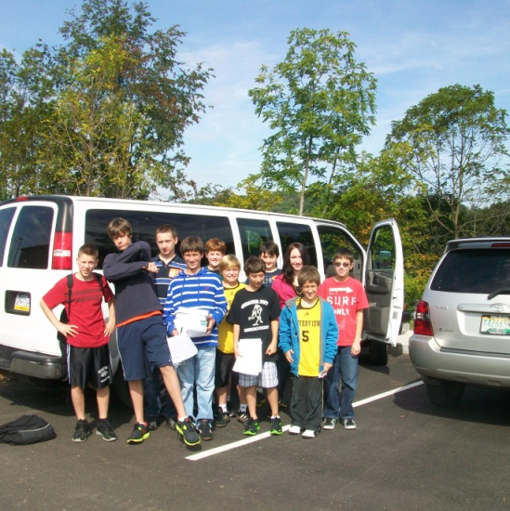
EQUATIONS TRAINING
RIVERVIEW ENRICHMENT ACTIVITIES -- Fall 2011

Slide 2
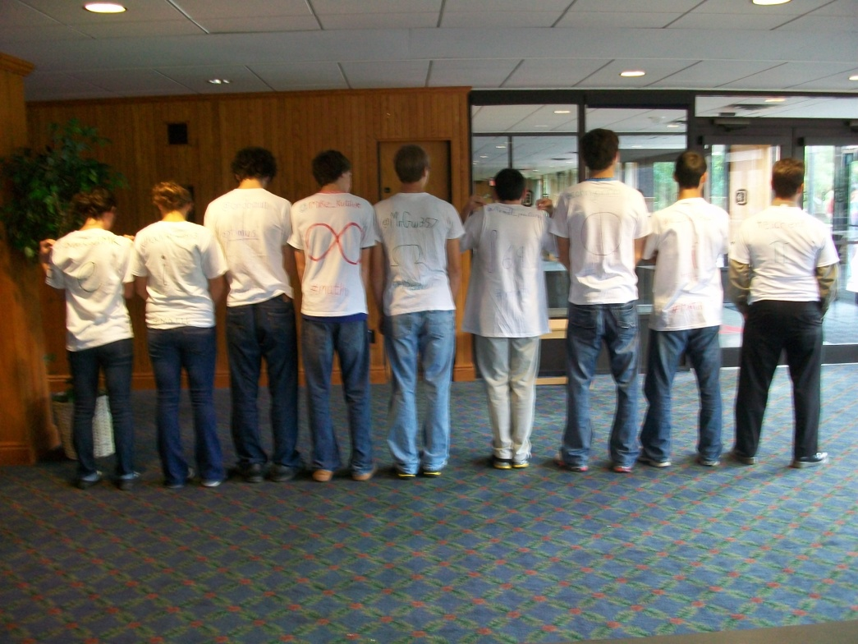
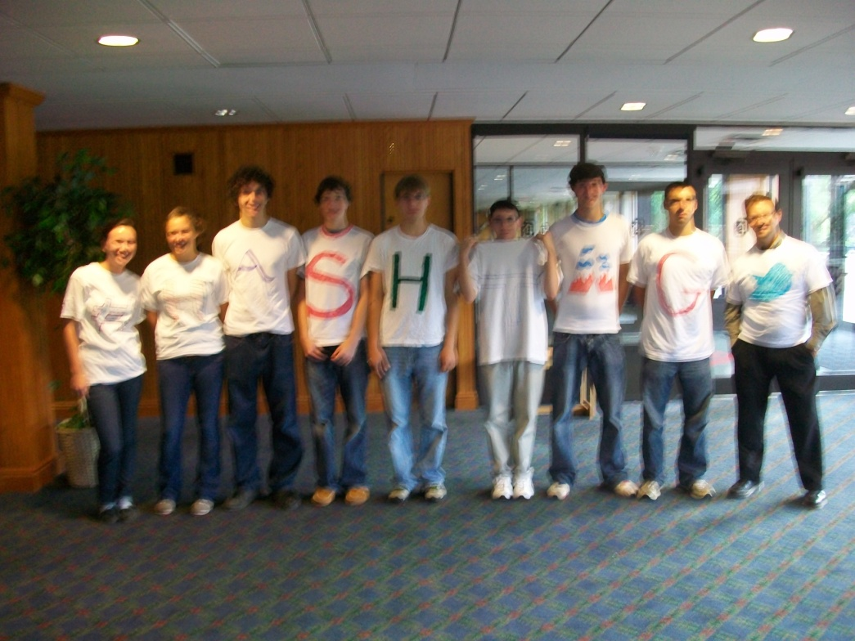
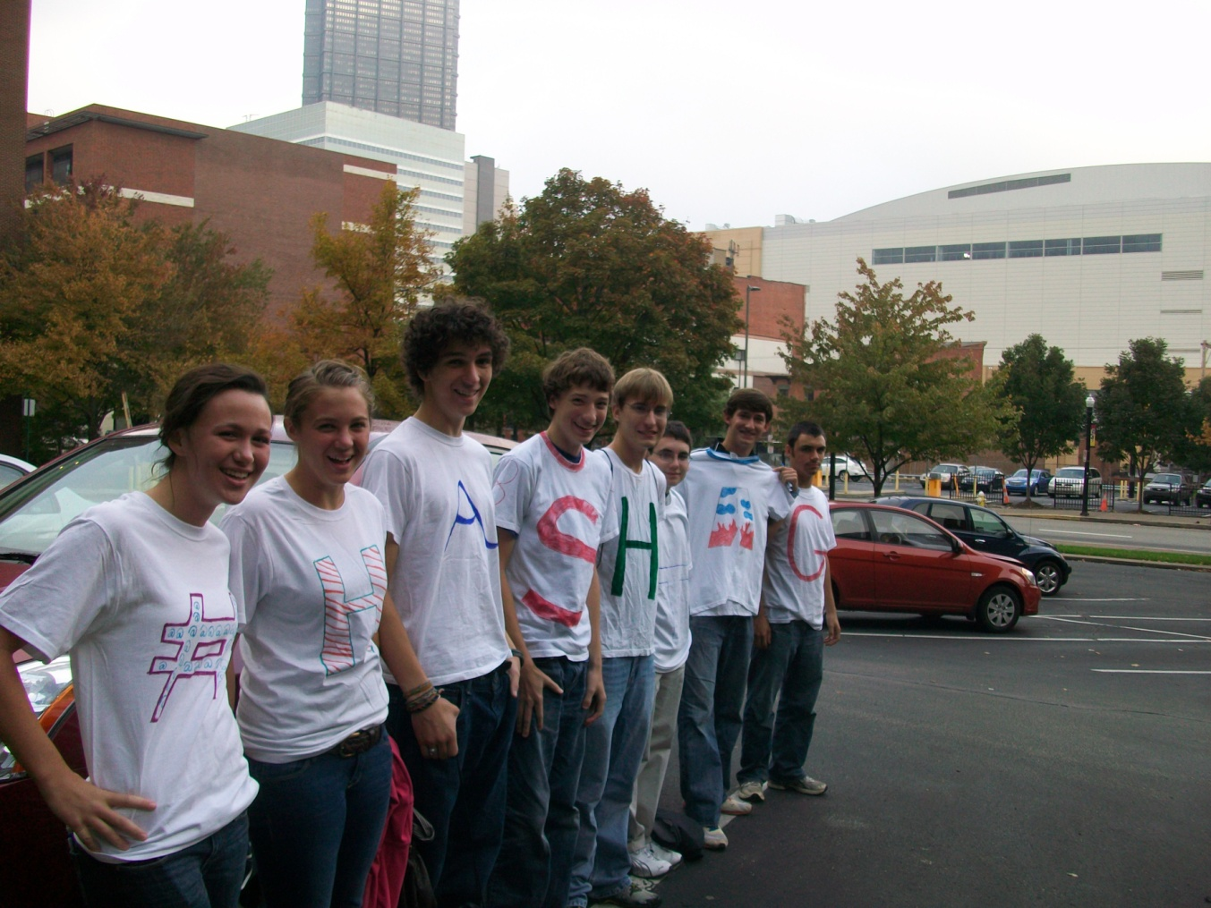
CALCU-SOLVE 11-12
To add your own pages, click the Home tab, then click the New Slide gallery.

Slide 3
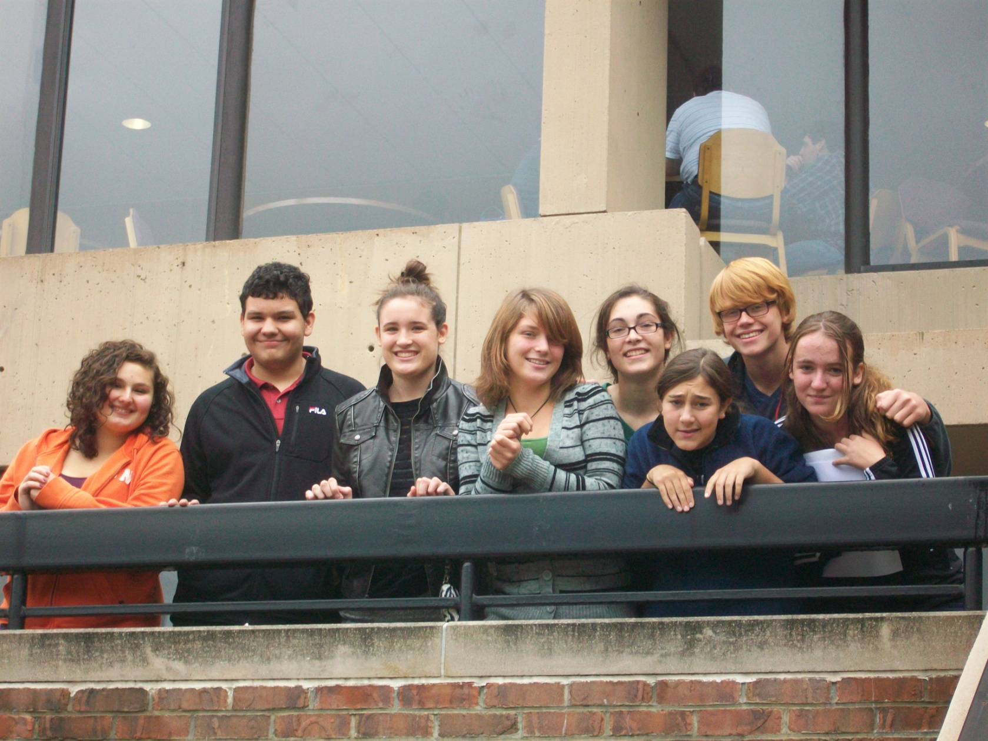
CALCU-SOLVE 9-10

Slide 4
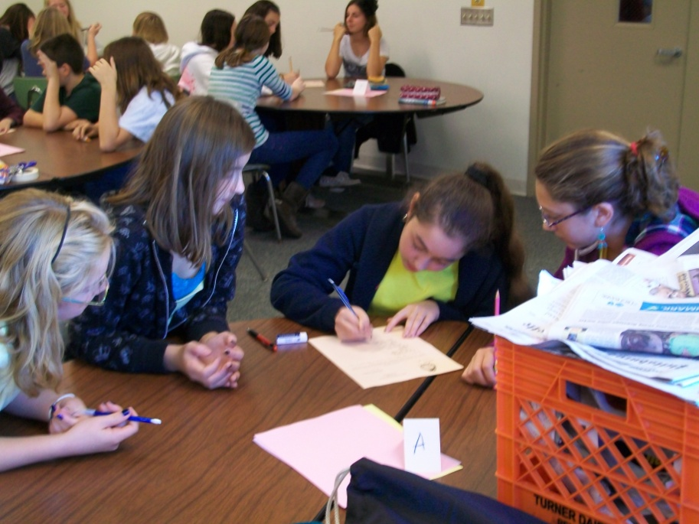
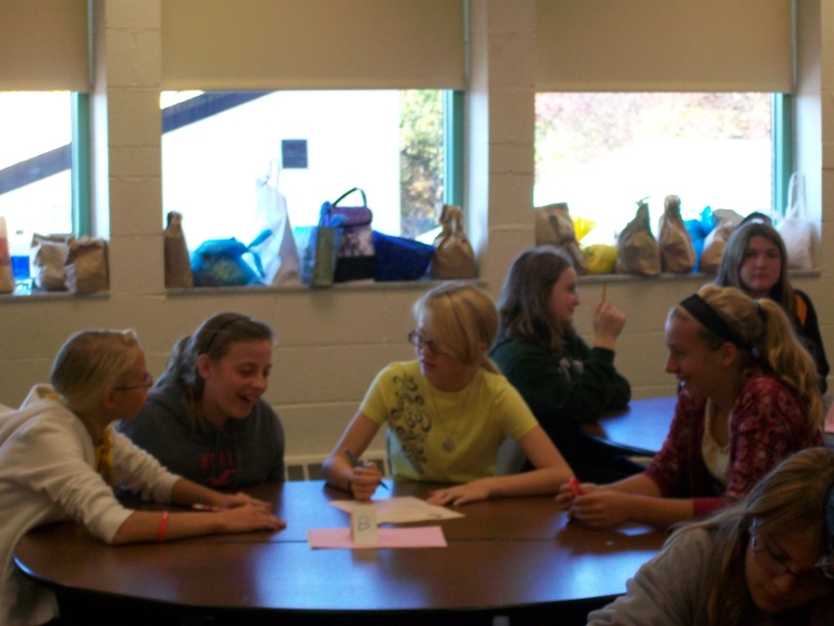
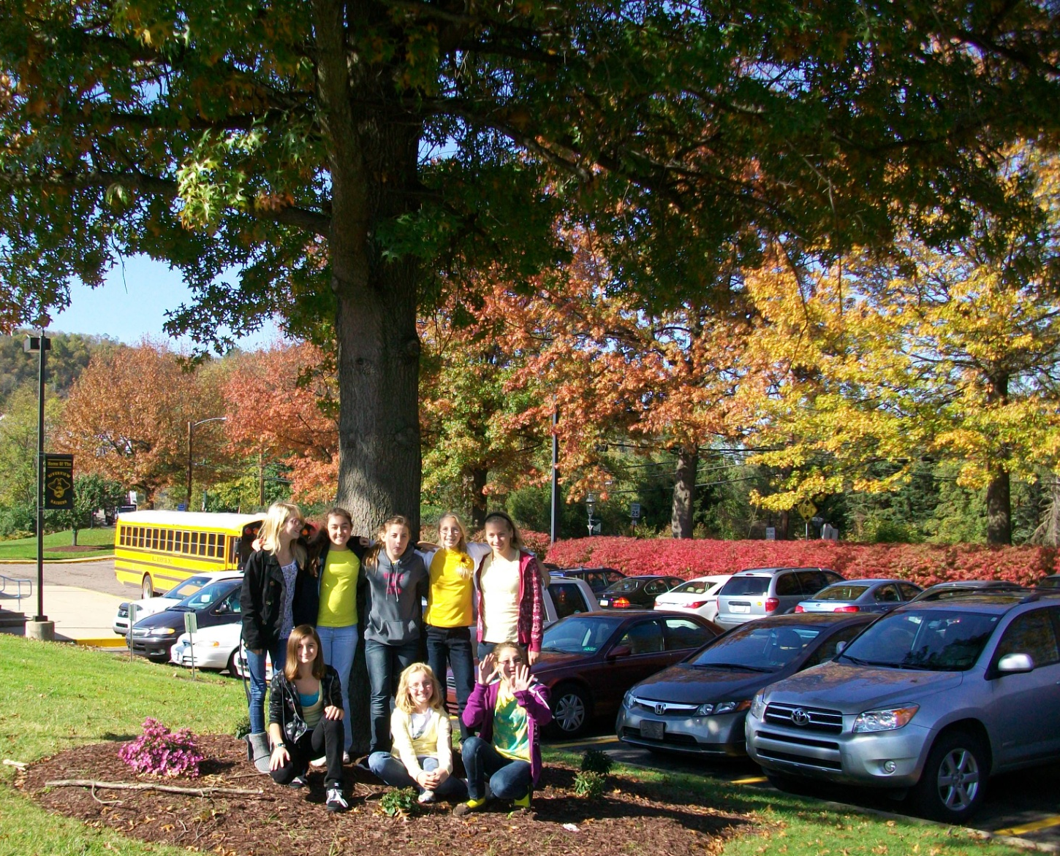
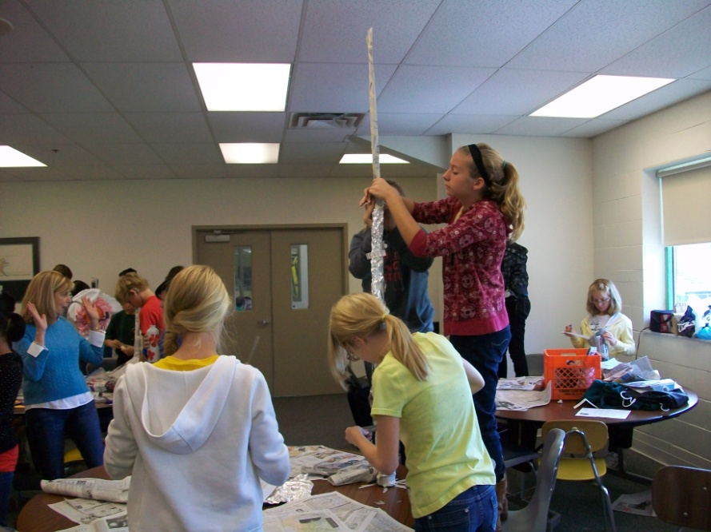
CREATIVE CONVENTION – 7th GRADE

Slide 5
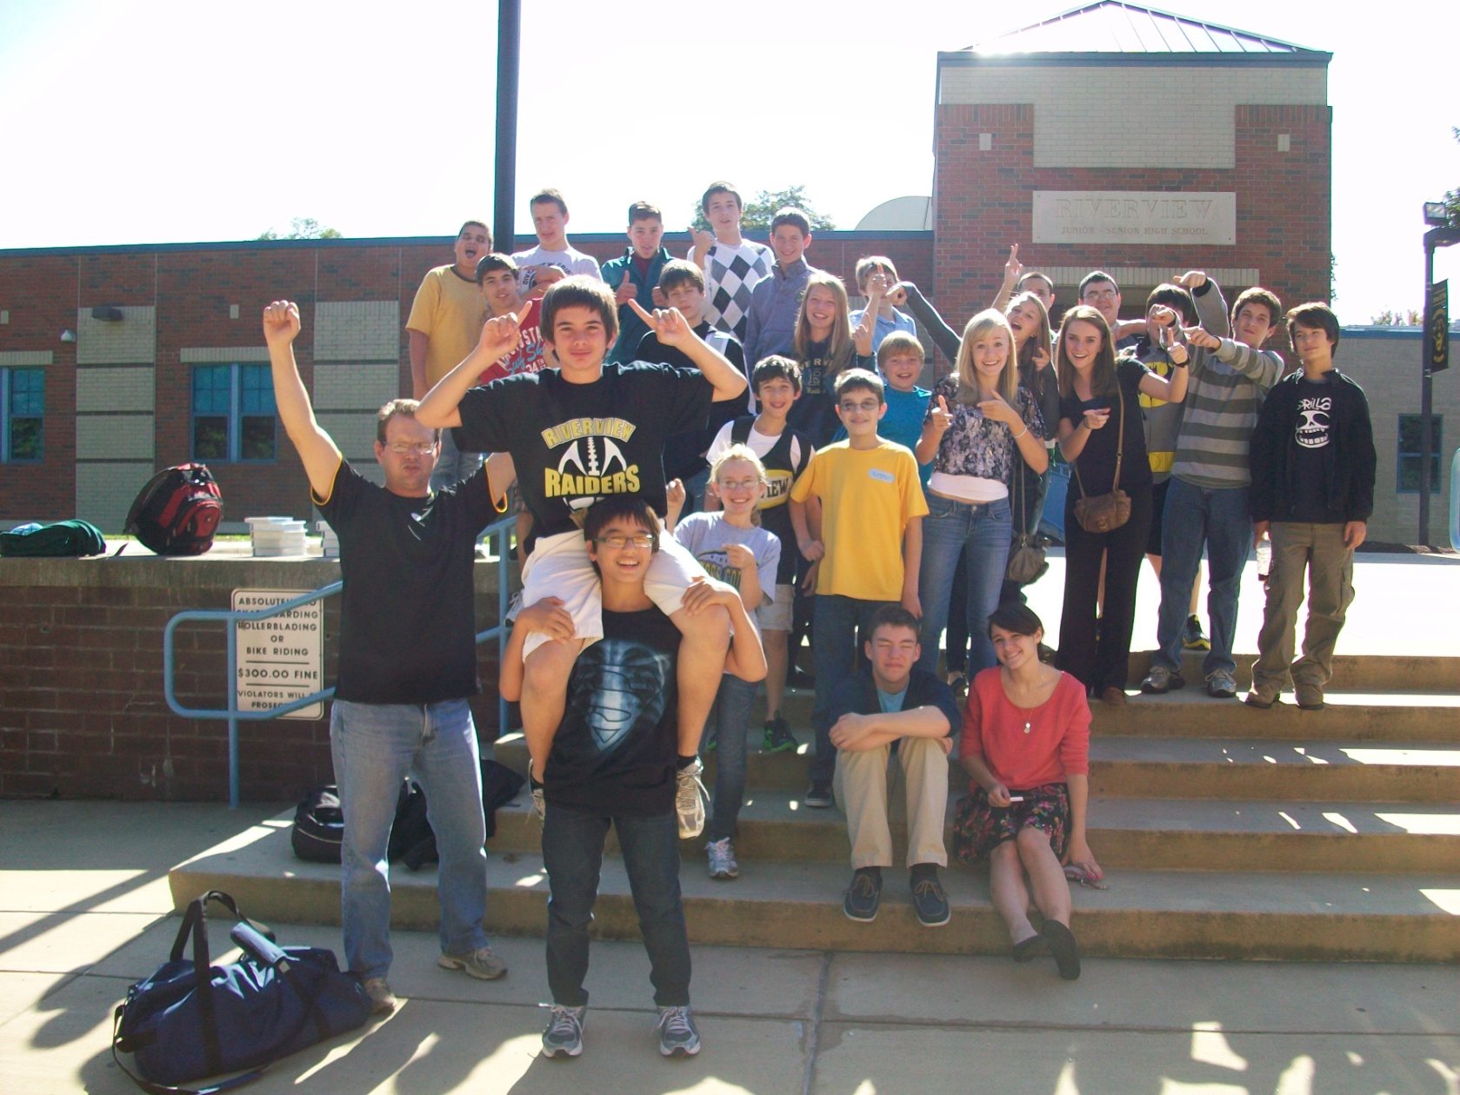
ACADEMIC GAMES - EQUATIONS

